Slide 1
Pharmacists beyond the counter : Improving vaccine accessibility Mayli Foong WA State Manager Pharmaceutical Society of Australia

Slide 2
Australia’s pharmacist vaccination journey
ALL VACCINES
ALL LOCATIONS
2015
QLD dTPa and MMR
Most states start pharmacist influenza vaccination
2016
ALL AGES
2014
Jurisdictions add more vaccines, inc. dTPa & MMR
QPIP starts Influenza
2016-2019
Pharmacists support COVID-19 vaccination roll-out
2021
2024
NIPVIP starts
2021- 2023
Travel Health Pilot (Victoria)
2024
Jurisdictions progressively add additional vaccines (e.g. HPV, JEV), reduce minimum age restrictions and increase NIP access via community pharmacy
-
Notes:
Celebrating a decade of pharmacist vaccination - Australian Pharmacist

Slide 3
Vaccines that pharmacists can prescribe (initiate) and administer July 2025
Pharmacist vaccine formulary 1 May 2024
Yellow fever
Rotavirus
TB
Varicella
Rabies
Typhoid
Hep B
MMR
mPox
Q fever
Hib
Herpes zoster
Polio
HPV
Influenza
JE
Men ACWY
Men B
Cholera
Hep A
Men C
RSV
COVID-19
Pneumo-
coccal
DTP
ACT
-
5
5
5
5
5*
18
10
5
5
5*
5
5
5
16
50 / 70
5
-
5
-
60 / ✓^
-
5
5
-
NSW
-
5
5
5
5
5*
18
9
2
5
5*
5
5
5
16
50 / 70
5
-
5
5
60 / ✓^
-
5
5
-
NT
-
5
5
5
5
5
5
5
5
5
5
5
5
5
18
5
5
-
-
-
5
-
-
5
-
QLD
2
✓
2
2
2
2
2
2
✓*
2
2
2
2*
2
2
2
2
-
2
✓
-
2
2
-
SA
✓
✓
✓
✓
✓
✓
✓
✓
✓
✓
✓
✓
✓
✓
✓
✓
✓
✓
✓
✓
✓
✓
✓
✓
✓
TAS
-
5
10
-
10
10*
18
10
5
10^
10*
10
10
-
-
10
10
-
10^
-
18
-
-
10
-
VIC
-
5
5#
-
5~
5*~
5$
5#
5
5
5*&
5&
-
-
5
5$
5~
-
-
-
5
-
5~
-
-
WA
-
5
5
-
-
5*
5
5
5*
-
5*
5
5
5
5
5
5
-
-
-
5
-
-
5
-
NIP or CVCP funded for eligible patients
State funded vaccines for eligible patients (asterisk * denotes additional eligibility beyond NIP)
Non-govt funded vaccines only
Not permitted
~Only under Victorian Community Pharmacist Statewide Program (VCPSP);
# For travel, min age 12 + only under VCPSP;
&For travel, min age 15 + only under VCPSP;
$For travel, min age 50 + only under VCPSP;
^Pregnant women 28–36 wks gestation
NIP funded vaccines may not be available for ordering by community pharmacies.
IMPORTANT: Additional restrictions may apply. Refer to state/territory pharmacist vaccination authorisations. Pharmacists must adhere to individual scope of practice, recommendations of the Australian Immunisation Handbook and ATAGI
Notes:
Dramatic expansion in recent years.
Doesn’t contain all vaccines – missing Yellow Fever, TB, Q Fever etc.

Slide 4
Vaccines that pharmacists can prescribe (initiate) and administer July 2025
Pharmacist vaccine formulary 1 May 2024
Yellow fever
Rotavirus
TB
Varicella
Rabies
Typhoid
Hep B
MMR
mPox
Q fever
Hib
Herpes zoster
Polio
HPV
Influenza
JE
Men ACWY
Men B
Cholera
Hep A
Men C
RSV
COVID-19
Pneumo-
coccal
DTP
ACT
-
5
5
5
5
5*
18
10
5
5
5*
5
5
5
16
50 / 70
5
-
5
-
60 / ✓^
-
5
5
-
NSW
-
5
5
5
5
5*
18
9
2
5
5*
5
5
5
16
50 / 70
5
-
5
5
60 / ✓^
-
5
5
-
NT
-
5
5
5
5
5
5
5
5
5
5
5
5
5
18
5
5
-
-
-
5
-
-
5
-
QLD
2
✓
2
2
2
2
2
2
✓*
2
2
2
2*
2
-
2
2
-
2
✓
-
2
2
-
SA
✓
✓
✓
✓
✓
✓
✓
✓
✓
✓
✓
✓
✓
✓
✓
✓
✓
✓
✓
✓
✓
✓
✓
✓
✓
TAS
-
5
10
-
10
10*
18
10
5
10^
10*
10
10
-
-
10
10
-
10^
-
18
-
-
10
-
VIC
-
5
5#
-
5~
5*~
5$
5#
5
5
5*&
5&
-
-
5
5$
5~
-
-
-
5
-
5~
-
-
WA
-
5
5
-
-
5*
5
5
5*
-
5*
5
5
5
5
5
5
-
-
-
5
-
-
5
-
NIP or CVCP funded for eligible patients
State funded vaccines for eligible patients (asterisk * denotes additional eligibility beyond NIP)
Non-govt funded vaccines only
Not permitted
~Only under Victorian Community Pharmacist Statewide Program (VCPSP);
# For travel, min age 12 + only under VCPSP;
&For travel, min age 15 + only under VCPSP;
$For travel, min age 50 + only under VCPSP;
^Pregnant women 28–36 wks gestation
NIP funded vaccines may not be available for ordering by community pharmacies.
IMPORTANT: Additional restrictions may apply. Refer to state/territory pharmacist vaccination authorisations. Pharmacists must adhere to individual scope of practice, recommendations of the Australian Immunisation Handbook and ATAGI

Slide 5
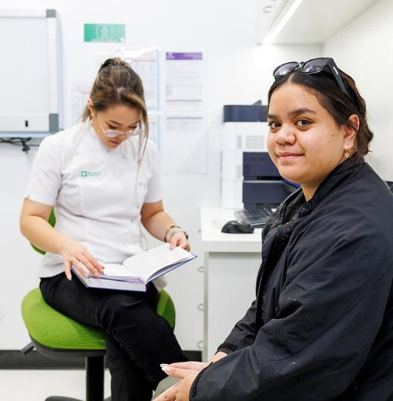
Accessibility of pharmacies
699
pharmacies
Many open after hours & weekends
96% live within 2.5km of pharmacy (metro)
74% live within 2.5km of pharmacy (regional)
18 visits
per person per year
Notes:
5935 pharmacies nationally

Slide 6


Slide 7



Slide 8
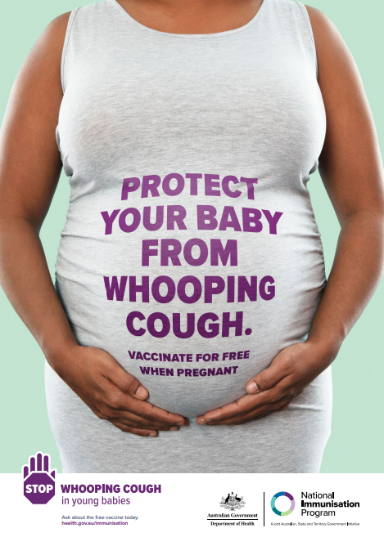

Notes:
Lots of public health campaigns

Slide 9
Vaccination trends Childhood (5 years age)
95% target
Source: AIR via https://www.health.gov.au/topics/immunisation/immunisation-data/human-papillomavirus-hpv-immunisation-data, Data as at 13 June 2025

Slide 10
Vaccination trends HPV
Shift from two-dose vaccine to one-dose vaccine
Source: AIR via https://www.health.gov.au/topics/immunisation/immunisation-data/human-papillomavirus-hpv-immunisation-data, Data as at 5 June 2025

Slide 11
Maturing role as vaccinators
Whole-of-life vaccinator
NIPVIP
Proactive offer of vaccination
Consideration of all required, routine and recommended vaccines
Patient recall and engagement
Campaign vaccinator
NIP
Community trust
Demand-driven
Focused on specific antigen(s)
Formulary growth
Experience

Slide 12
Influenza vaccination
Proportion influenza vaccines administered Australia (national) (all doses - Wk 35)
Source: AIR via Department of Health (Cwlth), Data as at 5 October 2025

Slide 13
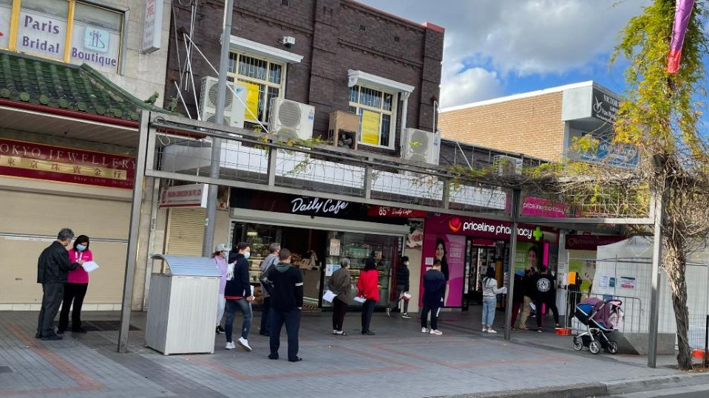
COVID-19 vaccination

Slide 14
AUSTRALIA: Pharmacy
COVID-19 vaccination
Average daily doses administered
13.6 million doses
All COVID-19 vaccines administered in community pharmacies, Source: AIR via Department of Health, Updated by PSA 8 October 2025

Slide 15
NIPVIP claims: by antigen
Shingles
Shingles
Shingles
Influenza
Influenza
Source: Department of Health (Cwlth), data current 30 September 2025

Slide 16
2025 YEAR TO DATE
NIPVIP claims: by antigen
Shingles
RSV
Pneumococcal
Influenza
Pertussis
Men ACWY
HPV
Measles
Source: Department of Health (Cwlth), data current 30 September 2025

Slide 17
Maturing role as vaccinators
Whole-of-life vaccinator
NIPVIP
Proactive offer of vaccination
Consideration of all required, routine and recommended vaccines
Patient recall and engagement
Campaign vaccinator
NIP
Community trust
Demand-driven
Focused on specific antigen(s)
Formulary growth
Experience

Slide 18
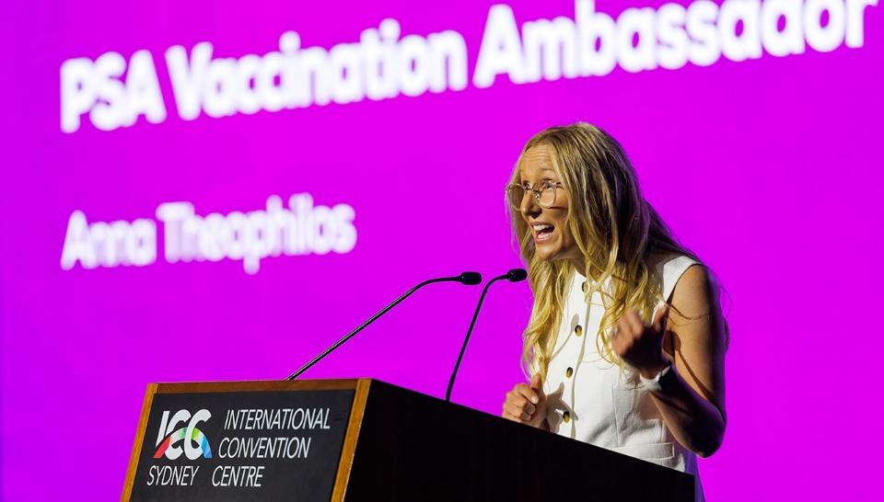

Slide 19


Slide 20
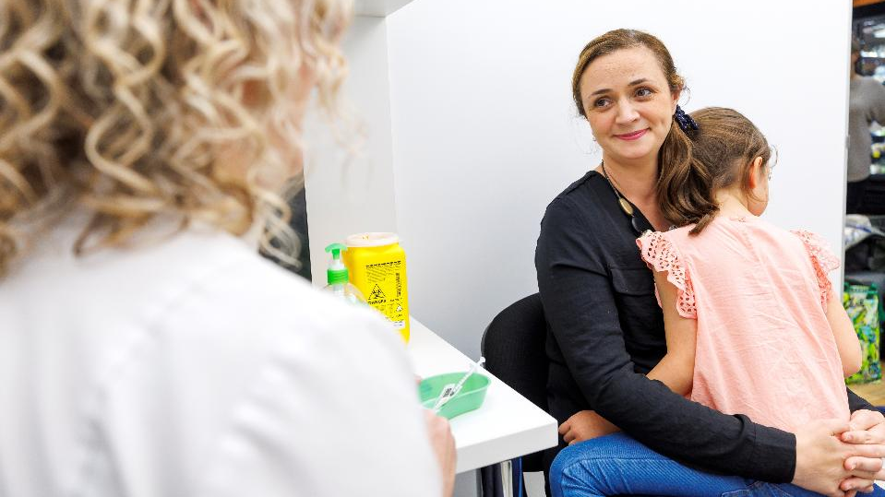
Where to next?

Slide 21
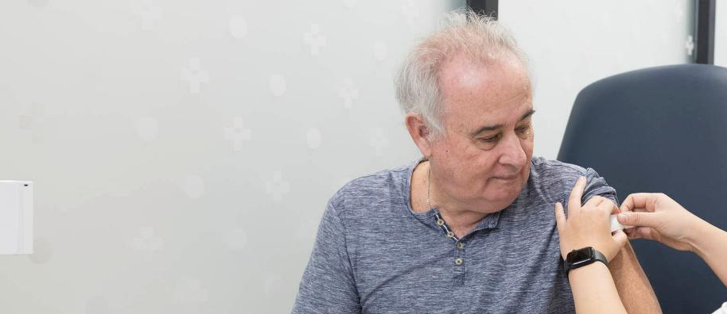
Practice changes to drive vaccination

Slide 22
Addressing barriers
Cultural and Language Barriers
Different cultural beliefs about illness and treatment.
Need for multilingual resources and outreach.
System Pressures
Daily workflow
Reminder system.
Supply issue.
Parental Hesitancy
Concerns about side effects and vaccine safety.
Influence of misinformation and social media.
Distrust.
Access and equity
Remote and rural areas face clinic shortages.
Difficult appointment scheduling for working families.
Barriers like transportation, cost, or lack of awareness.

Slide 23
Evidence based conversations
Ready to vaccinate
Patients with questions
Declining vaccination
Prevent hesitancy
Promote timely vaccination
Vaccinate
Increase vaccine confidence
Maintain trust
Keep conversation brief
Encourage patients to ask questions
Talk about what to do after vaccination, including adverse effects
Vaccinate and book follow-up
Questions to saturation.
Gather full list of questions before responding.
Share resources
Book appointment(s)
Discuss decision
Avoid debates about validity of beliefs
Acknowledge choice and respect
Offer patient resources and information
Revisit the discussion later
Refer if relevant

Slide 24
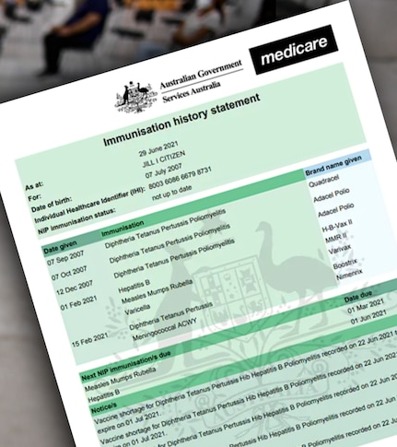
Review missing vaccines at every vaccination event
Notes:
Look at what is due
Image source: ABC News

Slide 25
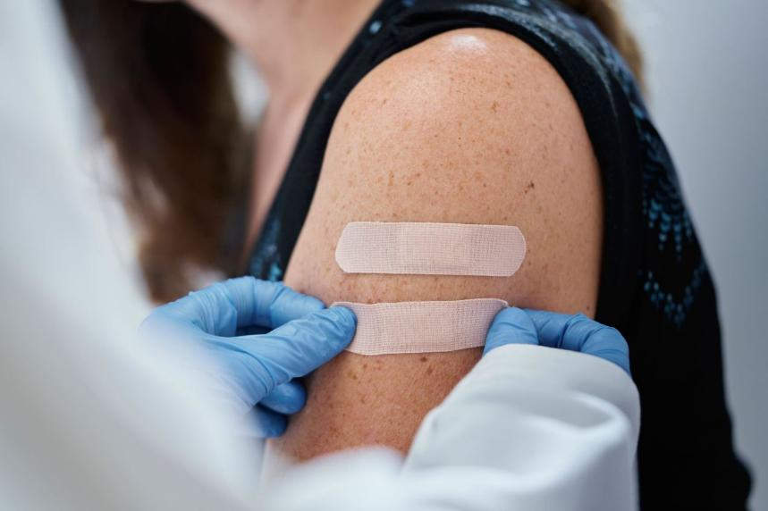
Focus on co-administration
For older patients, in 2025 they are recommended for up to five vaccines:
COVID-19
Influenza
RSV (Arevexy)
Pneumococcal
Shingles (Shingrix)
…and potentially others!

Slide 26
Thank you

